Slide 1

Storytelling Case Study: Airbnb, NYC
Touseef Ashrafi
Erwin James
Shaik

Slide 2

OBJECTIVE
Airbnb is an online platform using which people can rent their unused accommodations.
During the covid time, Airbnb incurred a huge loss in revenue.
People have now started travelling again and Airbnb is aiming to bring up the business again and e ready to provide services to customers.

Slide 3
BACKGROUND
For the past few months, Airbnb has seen a major decline in revenue.
Now that the restrictions have started lifting and people have started to travel more, Airbnb wants to make sure that it is fully prepared for this change.
So, analysis has been done on a dataset consisting of various Airbnb listings in New York.

Slide 4

Large Image slide
DATA PREPARATION
Cleaned data to remove any missing values and duplicates.
Dropped insignificant columns.
Identified outliers
Find the story within the data
Consider your audience
Determine what data matters
Analyze data and find insights

Slide 5
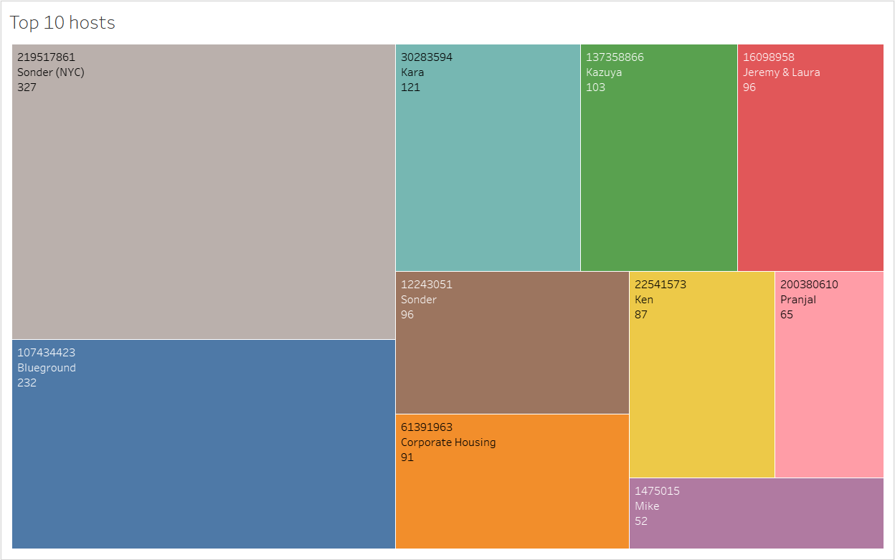
Top 10 Host
Host Sonder (id 219517861), has been booked the greatest number of times i.e. 327.
Host Blue ground is the second popular host.
Then there are other hosts like Kara, Ken, Pranjal, Jeremy and Mike that fall under top 10 hosts.

Slide 6




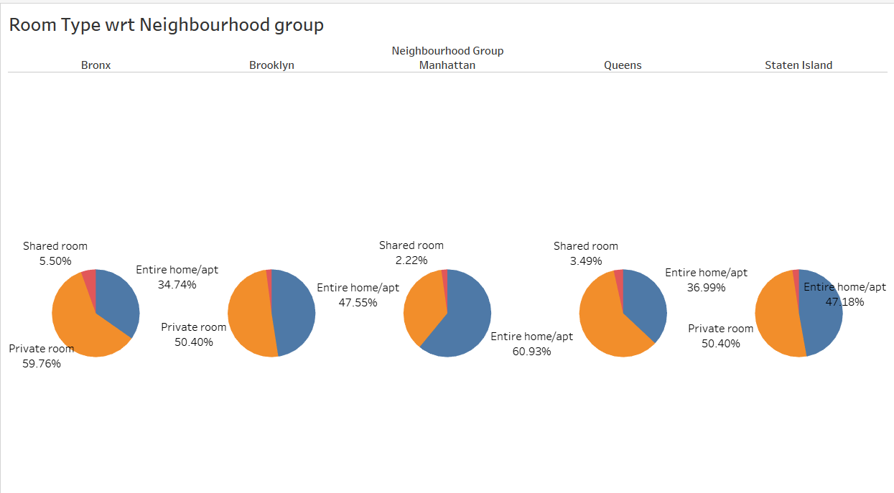
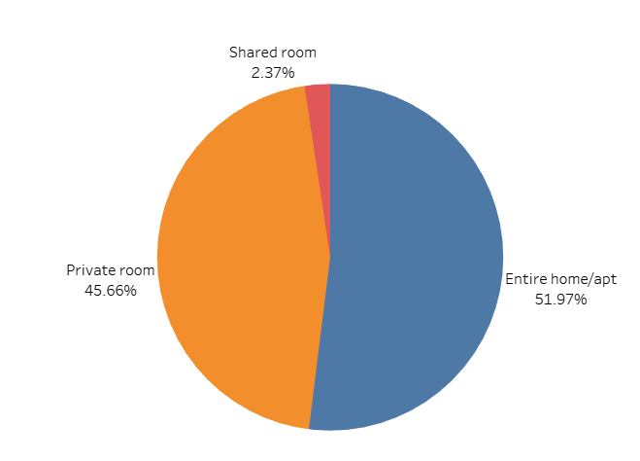


Room type with respect to Neighbourhood group
There are three types of rooms - Entire home/Apartment, Private room & shared room.
Overall, customers appear to prefer private rooms (45%) or entire homes (52%) in comparison to shared rooms (2.4%).
Airbnb can concentrate on promoting shared rooms with discounts to increase bookings and also acquire more private listings.
Queens & Bronx contribute 60% each to private rooms, more than the combined ratio of 45% Whereas, Manhattan has a higher contribution in entire home (61%), compared to the combined ratio of 52%.
1
2
3
4
5
6

Slide 7
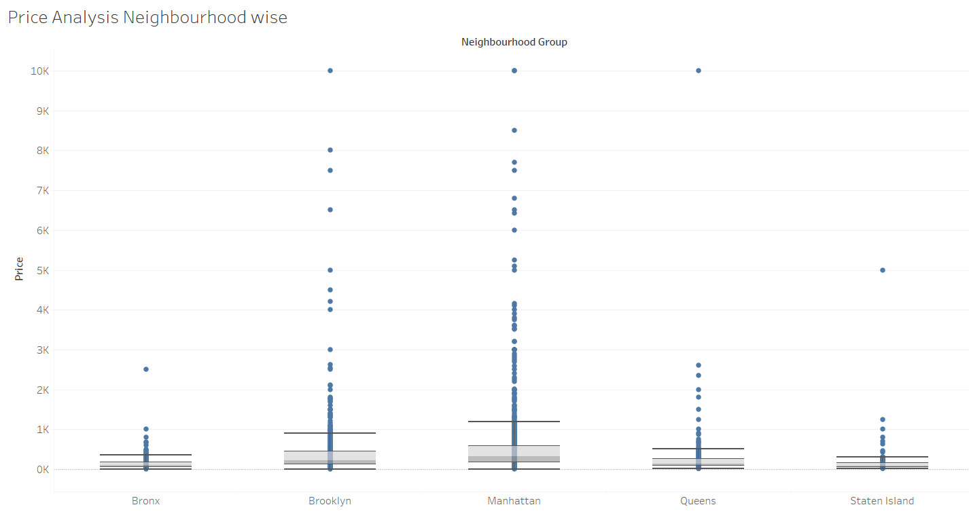
Price Analysis Neighbourhood wise
Most of the outliers in Price column are for Brooklyn and Manhattan.
Also, Manhattan has the highest range of prices for the listings.
Bronx is the cheapest of them all.
We can see the median price of all neighbourhood groups lying between $ 80 to $ 300.
Price was highly positively skewed so median was very close the lower quartile with some outliers as seen in the boxplot below.
1
2
3
4
5
6

Slide 8

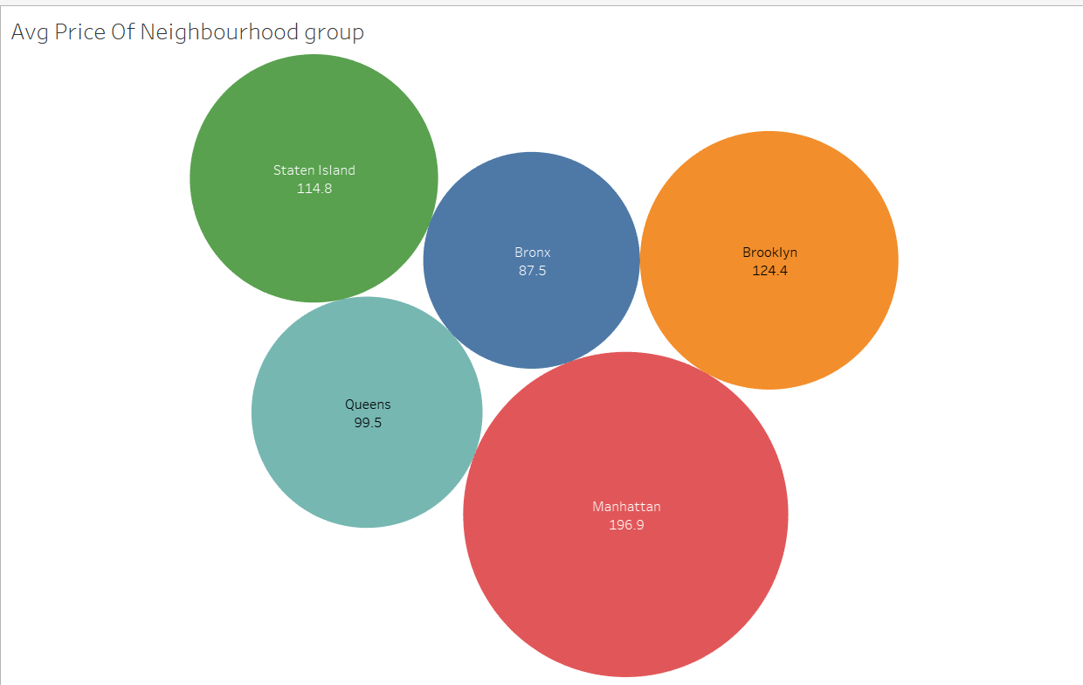
Average price of Neighbourhood groups
The average price of listed properties in Manhattan is around 196.9, which is highest among all neighbourhoods.
Average price for Brooklyn is second highest i.e. 124.4.
Bronx appears to be an affordable neighbourhood as the average price is almost half than Manhattan’s average price.

Slide 9
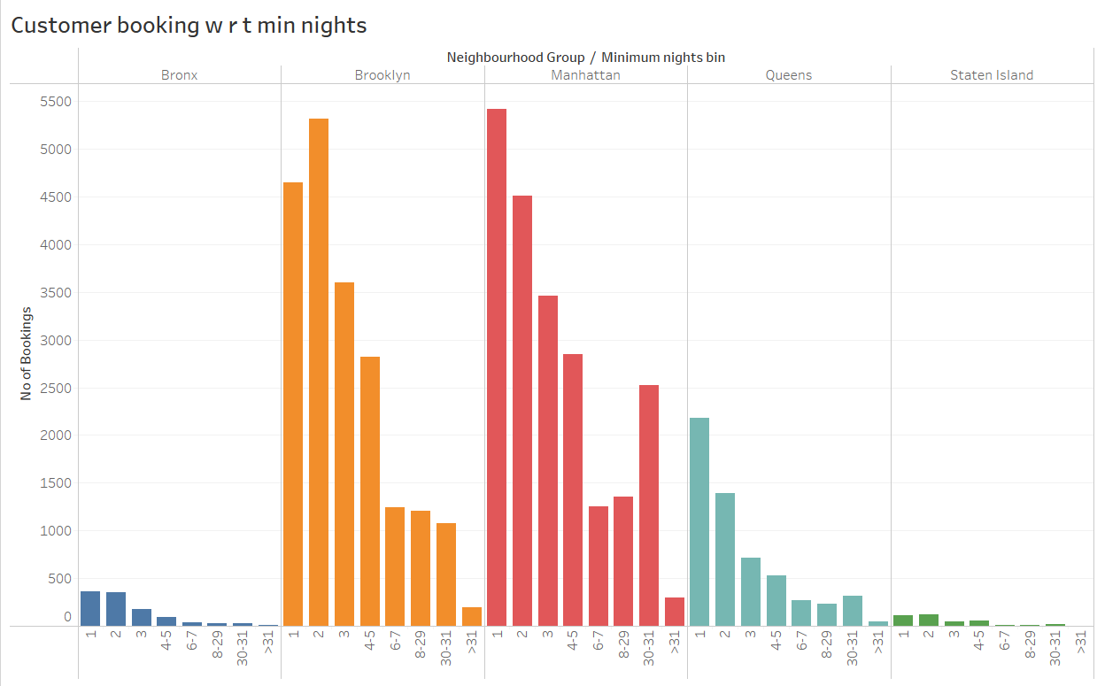
Customer Booking with respect to minimum nights
The listings with Minimum nights 1-5 have the most number of bookings. We can see a prominent spike in 30 days, this would be because customers would rent out on a monthly basis.
After 30 days, we can also see small spikes, this can also be explained by the monthly rent taking trend.
Manhattan &Queens have higher number of 30 day bookings compared to the others. The reason could be either tourists booking long stays or mid-level employees who opt for budget bookings due company visits

Slide 10
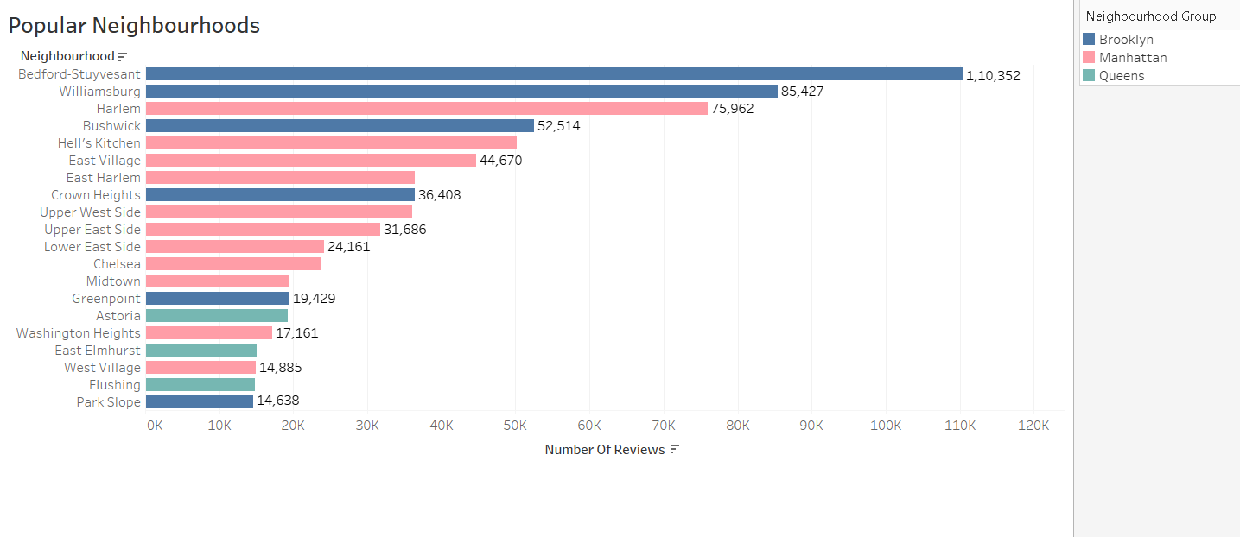
Popular Neighborhoods
We see that Bedford-Stuyvesant from Brooklyn is the highest popular with 1,10,352 no of reviews in total followed by Williamsburg.
Harlem from Manhattan got the highest no of reviews followed by Hell’s kitchen.
The higher number of customer reviews imply higher satisfaction in these localities.

Slide 11
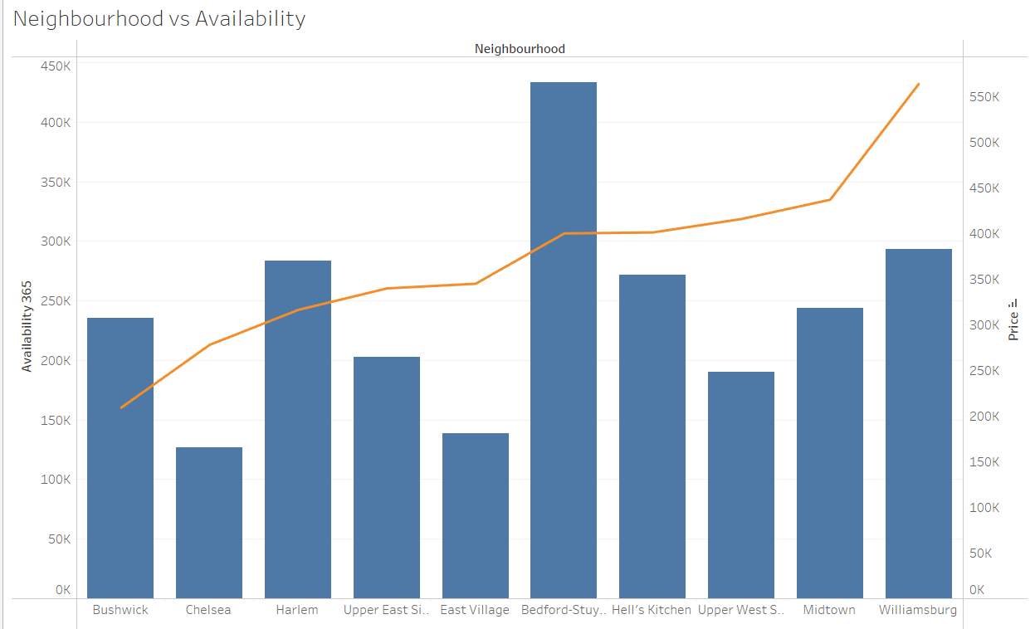
Neighbourhood vs Availability
Availability of Bedford is highest, and its price is on the lower side. It is a good choice for customers. After Bedford, Harlem follows the same trend. Chelsea’s availability low but it is costly. On the other hand, William’s price is high and has average availability.

Slide 12


Thank You
TOUSEEF ASHRAFI – ERWIN - SHAIK
Touseef.ashrafi07@gmail.com

